Slide 1

SWD 392 - Software Architecture and Design

Slide 2
Case Study
CHAPTER 21: Client/Server Software Architecture
Case Study

Slide 3
Table of contents
01
Problem Description
09
Structuring the System into Subsystems
02
Use Case Model
01
Design of ATM Client Subsystem
10
03
Static Modeling
11
Design of Banking Service Subsystem
04
Object Structuring
12
Relational Database Design
05
Dynamic Modeling
13
Deployment of Banking System
06
ATM State chart
14
Alternative Design Considerations
07
Design of Banking System
15
Detailed Design
08
Integrating the Communication Model

Slide 4
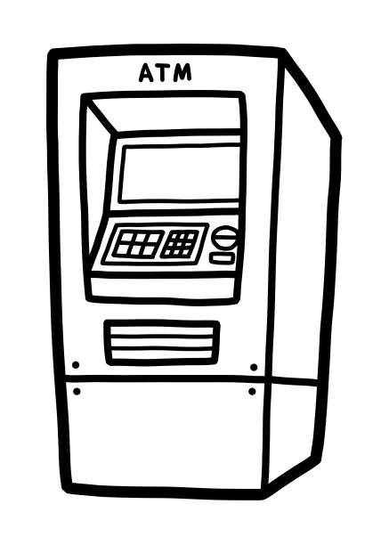
01 Problem description
The ATM Dilemma
A Bank has multiple automated teller machines (ATMs) distributed in multiple locations.
When a customer inserts an ATM card into the card reader, the system has to validate the card and the user to ensure that the card is not lost or stolen.
If the PIN entered by the user is false for the third time, the card is confiscated.
If both the card and the user are valid, a withdrawal, query or transaction can be made.
When the transaction is finished, the card is ejected along with the requested amount of money and a receipt.
Customer can cancel the transaction at any time.

Slide 5
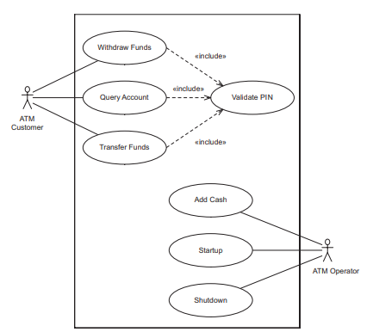
02 Use Case Model
Actors: ATM Customer & Operator
The customer can withdraw funds from a checking or savings account, query the balance of the account, and transfer funds from one account to another.
The ATM operator can shut down the ATM, replenish the ATM cash dispenser, and start the ATM.
Since these actions can be done separately, it is more flexible to have three separate use cases instead of one.
Reading the ATM card and validating PIN are required for all use cases of the customer. This common action is factored out as an inclusion use case called Validate PIN.
Banking System use case model

Slide 6
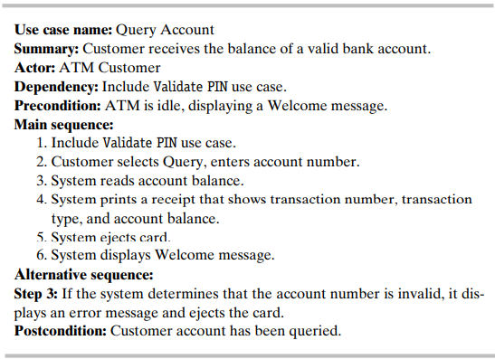
02 Use Case Model
Use case name: name of the use case
Summary: briefly describe what the use case will achieve
Actor: the user or anything that exhibits behavior when interacting with the system
Dependency: the use case that will be include in the base use case
Precondition: the state that the system must be in for the use case to be able to start
Main sequence: specific sequence of actions and interactions between actors and the system that will likely to happen most of the time
Alternative sequence: step or a sequence of steps that achieves the use case’s goal following different steps than described in the main sequence
Postcondition: states that the system can be in after the use case runs
Use case for Query Account

Slide 7
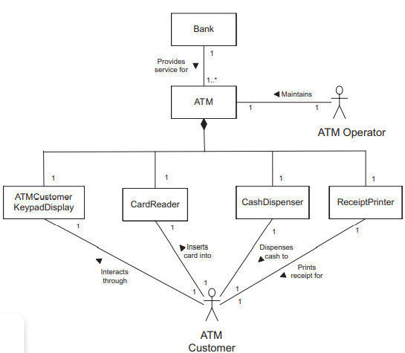
03 Static Modeling
Problem domain definition: functional areas of the business that are affected by the problem in question or that may be impacted by a solution to that problem
Model breakdown:
A Bank has multiple ATMs.
An ATM consists of a Card Reader, a Cash Dispenser, a Receipt Printer, and a Customer Keyboard Display.
The ATM Customer actor inserts the card into the Card Reader and responds to system prompts though the ATM Customer Keyboard Display.
The Cash Dispenser dispenses cash to the Customer actor.
The Receipt Printer prints a receipt for the ATM Customer.
In addition, the Operator actor is a user whose job is to maintain the ATM.
Conceptual static model for problem domain

Slide 8
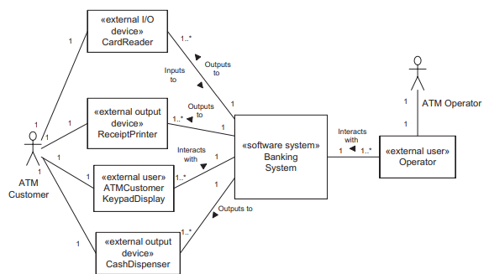
03 Static Modeling
Diagram breakdown:
The ATM Operator interacts with the system via a keypad and display.
The ATM Customer actor interacts with the system via four I/O devices, which are the card reader, cash dispenser, receipt printer, and ATM Customer keypad/display.
Both Customer Keypad/Display and Operator are modeled as external users since these two are directly used by the actors to communicate to the system.
The software system context class diagram for the Banking System depicts the software system as one aggregate class that receives input from and provides output to the external classes.
Banking System software context class diagram

Slide 9
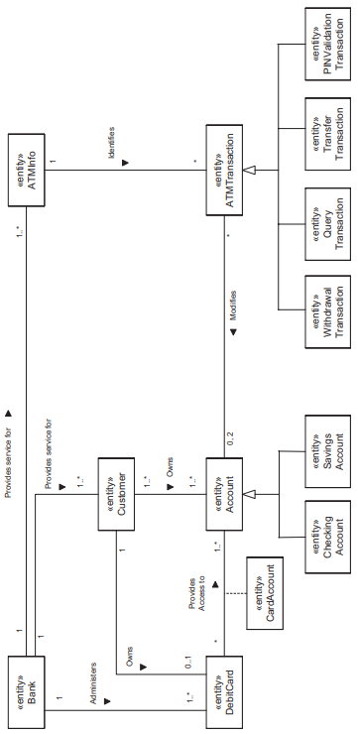
03 Static Modeling
Conceptual static model for Banking System: entity classes

Slide 10
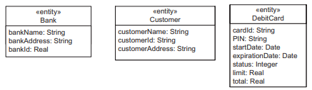
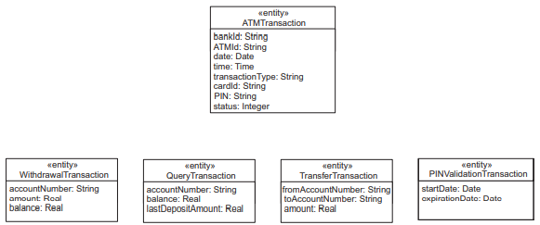
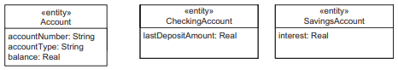
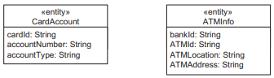
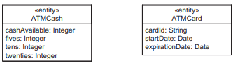
03 Static Modeling
Conceptual static model for Banking System: classes attributes

Slide 11
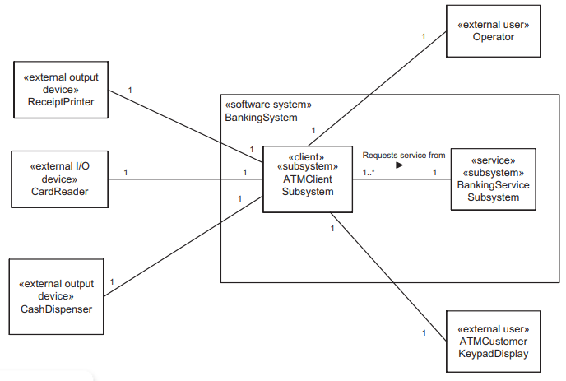
04 Object Structuring
Client/Server Subsystem Structuring
Because the Banking System is a client/server application, some of the objects are part of the ATM client and some objects are part of the banking service.
There is a client subsystem called ATM Client Subsystem, of which one instance is located at each ATM machine.
There is also a service subsystem, the Banking Service Subsystem, of which there is one instance.
Both subsystems are depicted as aggregate classes, with a one-to-many association between the Banking Service Subsystem and the ATM Client Subsystem.
Banking System: major subsystem

Slide 12
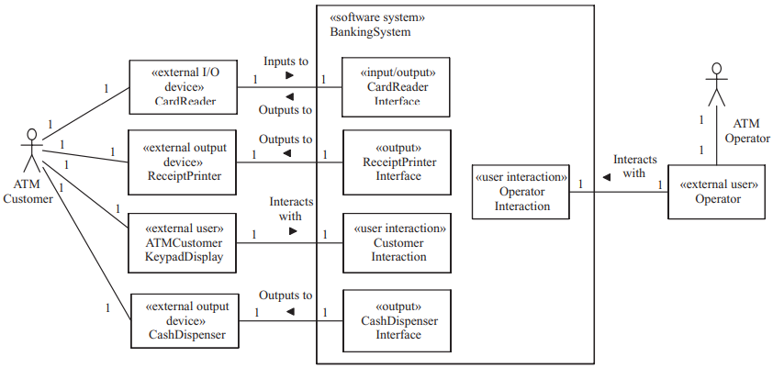
04 Object Structuring
Banking System external classes and boundary classes

Slide 13
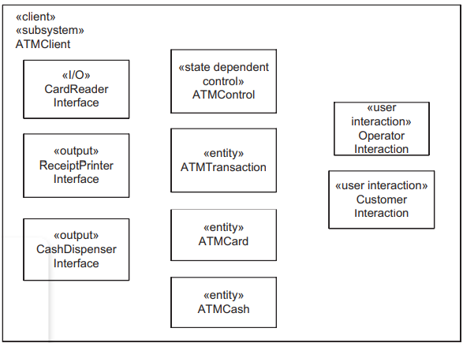
04 Object Structuring
Determine the Objects participating in Use Cases
Validate PIN use case example:
The customer inserting the ATM Card into the card reader
The system prompting for the PIN, and the system checking whether the customer-entered PIN matches the PIN maintained by the system for that ATM card number
=> We need a Card Reader Interface to read the ATM card, a ATM card entity to store the information, interact with the customer through the Customer Interaction, store the transaction details in ATM Transaction entity, and to control the sequence in which actions at the ATM take place in ATM Control object.
ATM Client subsystem classes

Slide 14



04 Object Structuring
Object Structuring in Service Subsystem
Several entity objects are bank-wide and need to be accessible from any ATM. Consequently, these objects must be stored in the Banking Service subsystem at the Server.
These objects include Customer objects that hold information about bank customers, Account objects (both checking and saving) that hold information about individual bank accounts, and Debit Card objects that hold information about all the debit cards maintained at the bank.
Business logic objects are also needed at the server to define the business-specific application logic for processing client requests.
For example, the business rules maintained by the Withdrawal Transaction Manager are that (1) the account must always have a balance greater or equal to zero after each withdrawal, and that (2) there is a maximum amount that can be withdrawn each day.

Slide 15
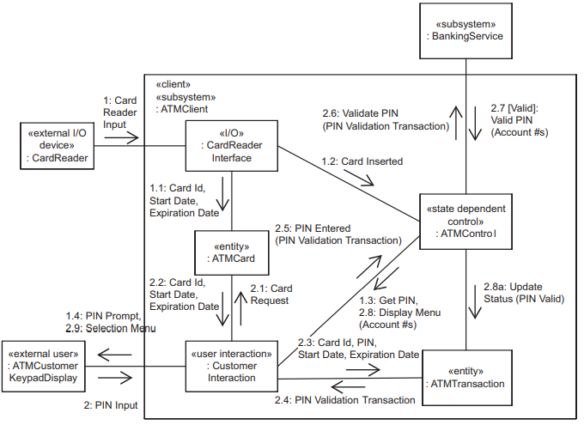
05 Dynamic Modeling
The dynamic model depicts the interaction among the objects that participate in each use case.
Message Sequence Description for Client-Side Validate PIN Interaction Diagram breakdown:
The client-side Validate PIN interaction diagram starts with the customer inserting the ATM card into the card reader.
The message sequence number starts at 1, which is the first external event initiated by the actor. Subsequent numbering in sequence, representing the messages arriving at software objects in the system, is 1.1, 02, 03 and ends with 04.
The next input from the actor is the external event numbered 2, followed by the internal events 2.1, 2.2, and so on.
Communication diagram: ATM client Validate PIN use case

Slide 16
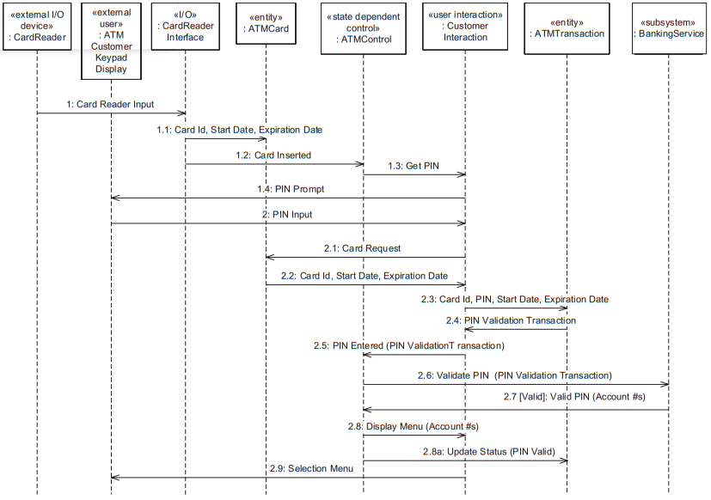
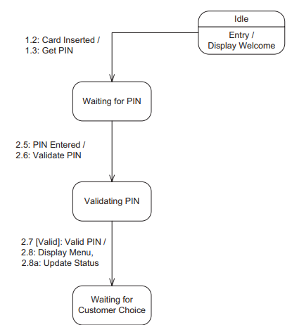
05 Dynamic Modeling
State chart for ATM Control: Validate PIN use case
Sequence diagram: ATM client Validate PIN use case

Slide 17
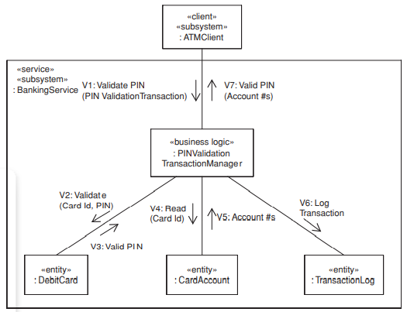
05 Dynamic Modeling
A. Message Sequence Description for Server-Side Validate PIN Interaction Diagram
To validate the PIN at the server, the Debit card entity object, which contains all the information pertinent to all debit cards that belong to the bank, needs to be accessed.
If PIN validation is successful, the Card Account entity object needs to be accessed to retrieve the account numbers of the accounts that can be accessed by this debit card.
In addition, each transaction has a business logic object that encapsulates the business application logic to manage the execution of the transaction (in this case, PIN Validation Transaction Manager)
Communication diagram: Banking Service Validate PIN use case

Slide 18
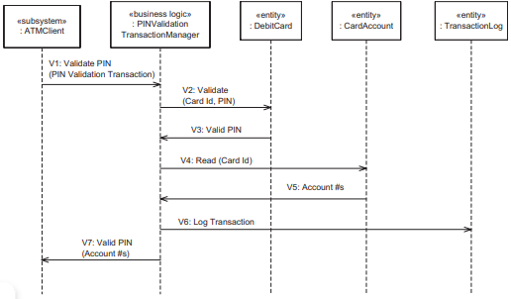
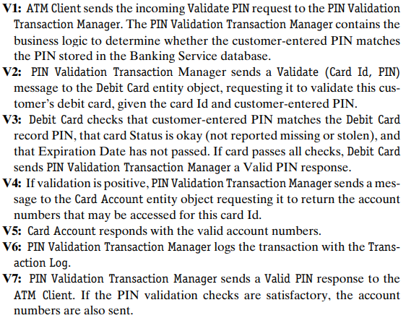
05 Dynamic Modeling
Message sequence description
Sequence diagram: Banking Service Validate PIN use case

Slide 19
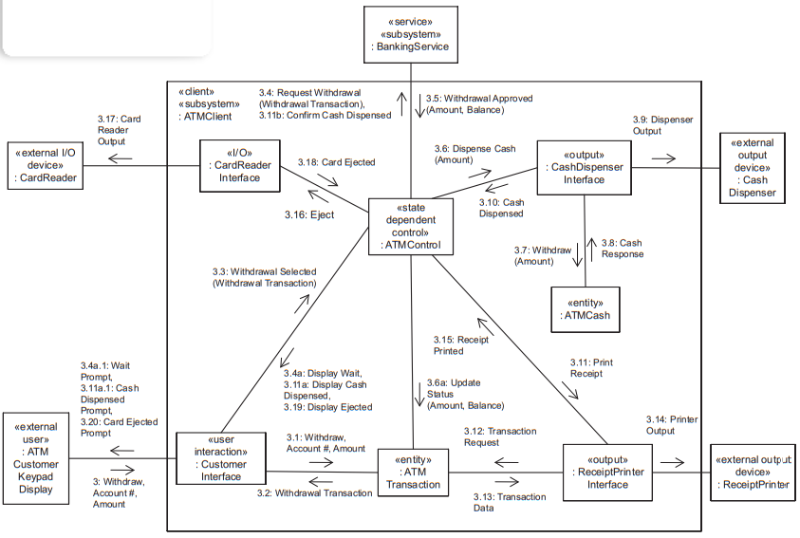
05 Dynamic Modeling
Communication diagram: ATM client withdraw funds use case

Slide 20
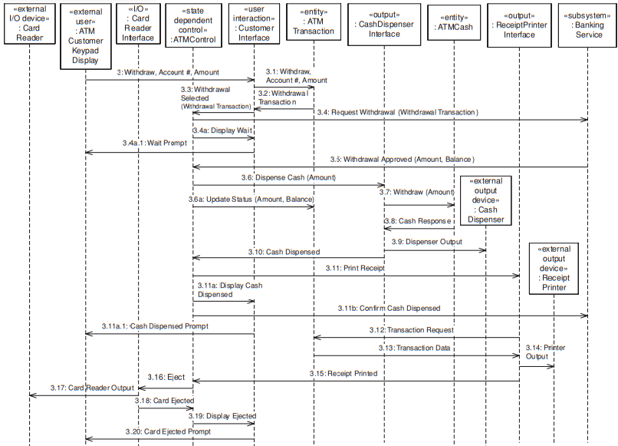
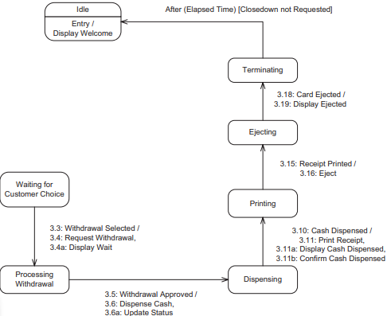
05 Dynamic Modeling
State chart: ATM client withdraw funds use case
Sequence diagram: ATM client withdraw funds use case

Slide 21
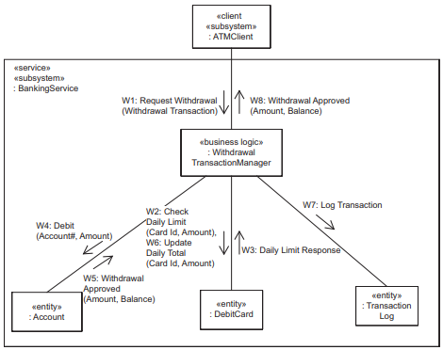
05 Dynamic Modeling
B. Message Sequence Description for Server-Side Withdraw Funds Interaction Diagram
The business logic object that participates in the server-side Withdraw Funds use case is the Withdrawal Transaction Manager, which encapsulates the logic for determining whether the customer is allowed to withdraw funds from the selected account.
The other business logic objects that participate in the server use cases are the Transfer Transaction Manager, which encapsulates the logic for determining whether the customer can transfer funds from one account to another.
The later Query Transaction Manager will check if the functionality could be handled by the read operation of the Account object.
Communication diagram: Banking Service
Withdraw Funds use case

Slide 22
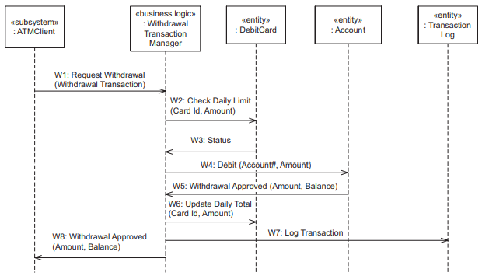
05 Dynamic Modeling
Sequence diagram: Banking Service Withdraw Funds use case

Slide 23
05 Dynamic Modeling
State chart: ATM client withdraw funds use case
Sequence diagram: ATM client withdraw funds use case

Slide 24
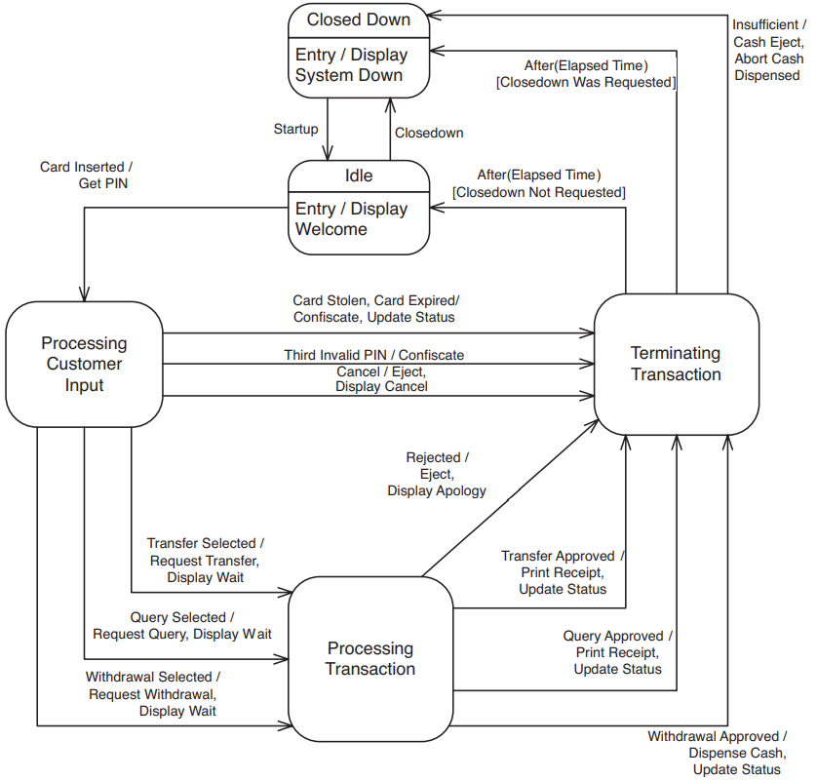
06 ATM Statechart
Because there is one control object, ATM Control, a state chart needs to be defined for it.
Five states are shown on the top-level state chart: Closed Down (which is the initial state), Idle, and three composite states, Processing Customer Input, Processing Transaction, and Terminating Transaction.
At system initialization time, given by the event Startup, the ATM transitions from the initial Closed Down state to Idle state. The event Display Welcome is triggered on entry into Idle state. In Idle state, the ATM is waiting for a customer-initiated event.
Top-level state chart for ATM Control

Slide 25
06 ATM Statechart
Because there is one control object, ATM Control, a state chart needs to be defined for it.
Five states are shown on the top-level state chart: Closed Down (which is the initial state), Idle, and three composite states, Processing Customer Input, Processing Transaction, and Terminating Transaction.
At system initialization time, given by the event Startup, the ATM transitions from the initial Closed Down state to Idle state. The event Display Welcome is triggered on entry into Idle state. In Idle state, the ATM is waiting for a customer-initiated event.
Top-level state chart for ATM Control

Slide 26
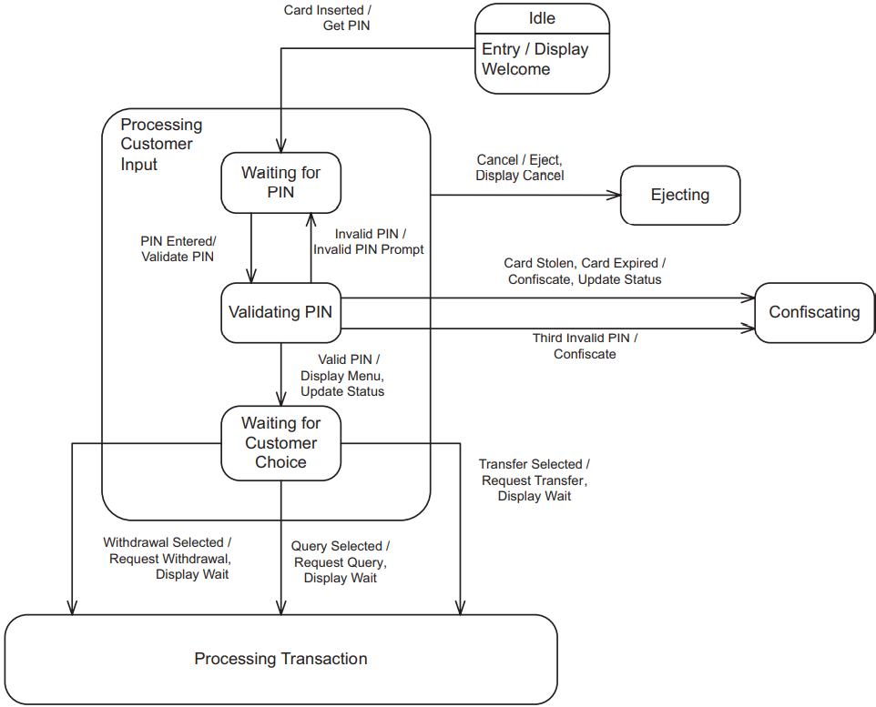
06 ATM Statechart
A. Processing Customer Input Composite State
The Processing Customer Input composite state is decomposed into three substates – Waiting for PIN, Validating PIN, and Waiting for Customer Choice:
Waiting for PIN. This substate is entered from Idle state when the customer inserts the card in the ATM, resulting in the Card Inserted event. In this state, the ATM waits for the customer to enter the PIN.
Validating PIN. This substate is entered when the customer enters the PIN. In this substate, the Banking Service validates the PIN.
Waiting for Customer Choice. This substate is entered as a result of a Valid PIN event, indicating a valid PIN was entered. In this state, the customer enters a selection: Withdraw, Transfer, or Query.
State chart for ATM Control: Processing Customer Input composite state (a)

Slide 27
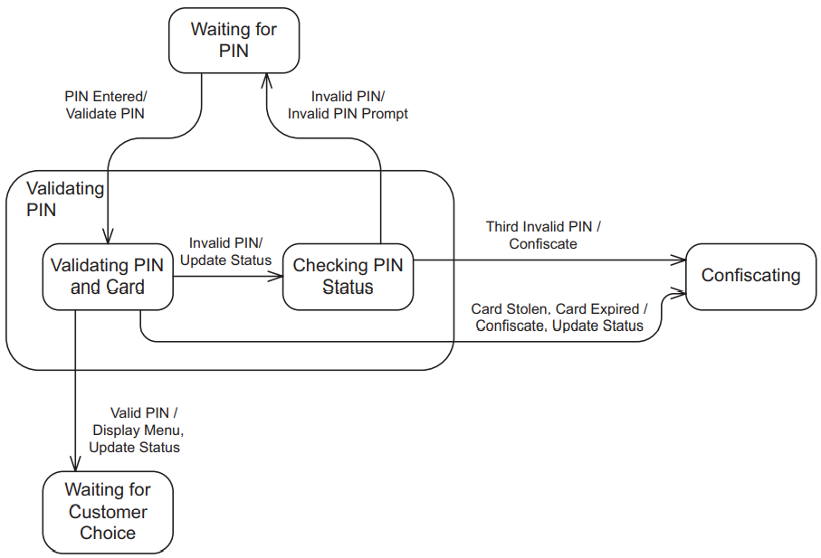
06 ATM Statechart
State chart for ATM Control: Processing Customer Input composite state (b)

Slide 28
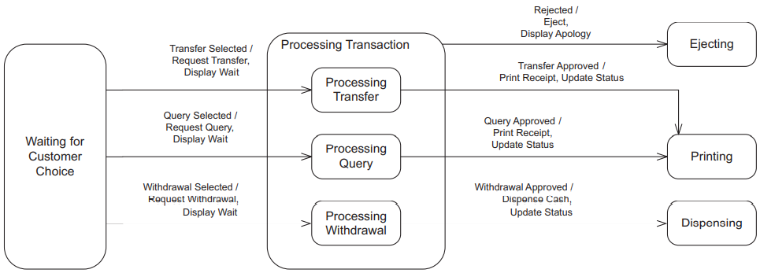
06 ATM Statechart
B. Processing Transaction Composite State
State chart for ATM: Processing Transaction composite state
The Processing Transaction composite state is also decomposed into three substates, one for each transaction: Processing Withdrawal, Processing Transfer, and Processing Query.

Slide 29
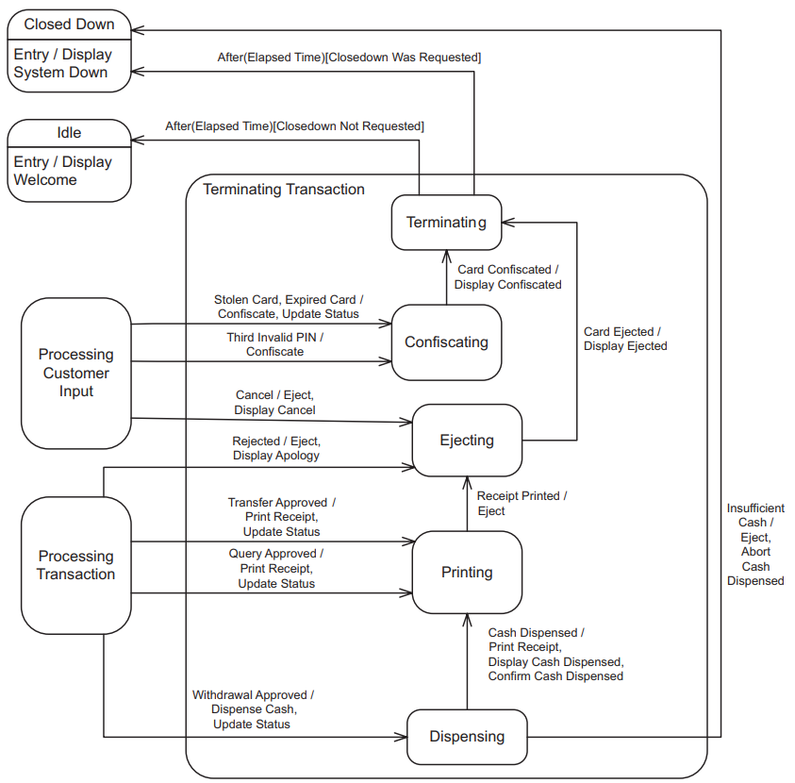
06 ATM Statechart
The Terminating Transaction composite state has substates for Dispensing, Printing, Ejecting, Confiscating, and Terminating.
The actions associated with the transition to Dispensing state are to Dispense Cash and Update Status.
After the Cash Dispensed event has taken place, the ATM transitions to Printing state to print the receipt.
The action Print Receipt is executed at the transition.
When the receipt is printed, the state Ejecting is entered and the Eject action is executed.
When the card has been ejected (event Card Ejected), the Terminating state is entered.
For the Query and Transfer transactions, the sequence of states following approval of the transaction is similar, except that no cash is dispensed, as can be seen on the ATM state charts.
State chart for ATM Control: Terminating Transaction composite state

Slide 30

07 Banking System Design
The analysis model of the Banking System is mapped to a design model. The steps in this process are as follows:
1. Integrate the communication model. Develop integrated communication diagrams.
2. Structure the Banking System into subsystems. Define the interfaces of the subsystems.
3. For each subsystem, structure the system into concurrent tasks.
4. For each subsystem, design the information hiding classes.
5. Develop the detailed software design.

Slide 31
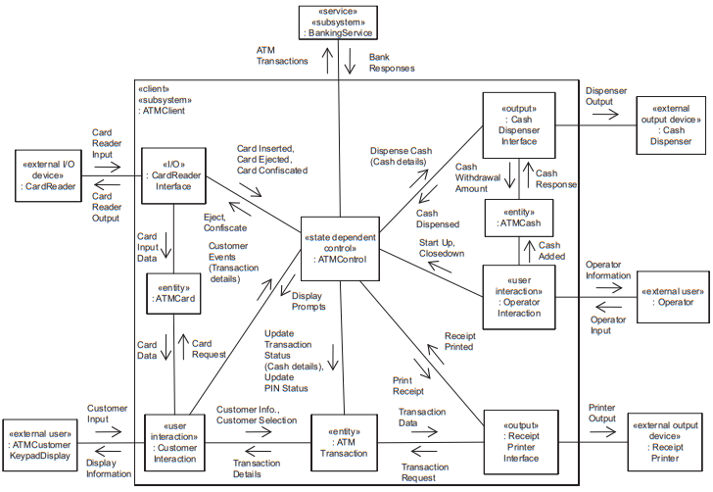
08 Communication Model
Integrated Communication diagram for ATM client subsystem

Slide 32
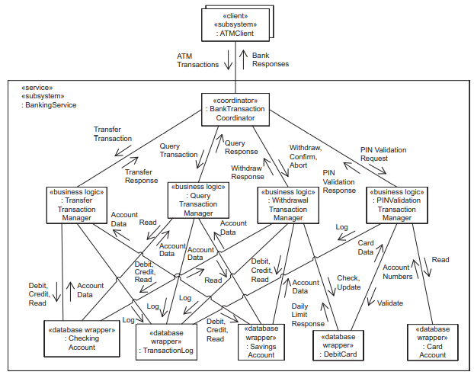
08 Communication Model
Integrated communication diagram for Banking Service subsystem

Slide 33
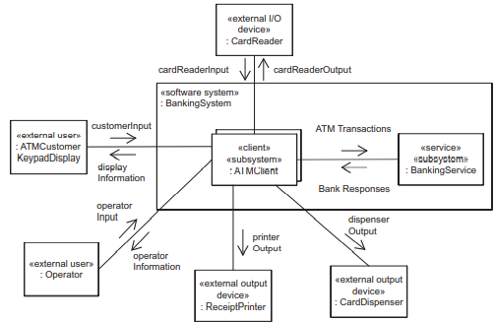
09 System Into Subsystems
There are two subsystems, the multiple instances of the ATM Client Subsystem and the Banking Service Subsystem.
The ATM Client Subsystem sends ATM Transactions to the Banking Service Subsystem, which responds with Bank Responses.
ATM Transactions is an aggregate message consisting of the PIN Validation, Withdraw, Query, Transfer, Confirm, and Abort messages.
Subsystem design: high-level communication diagram for
Banking System

Slide 34
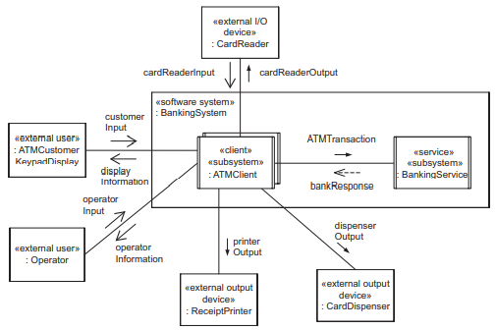
10 Design Of ATM Client Subsystems
To determine the tasks in a system, it is necessary to understand how the objects in the application interact with each other.
This is best depicted on the analysis model communication diagram, which shows the sequence of messages passed between objects in support of a given use case.
For the ATM Client Subsystem, consider the communication diagrams for the Client Validate PIN and Client Withdraw Funds use cases in addition to the integrated communication diagram for this subsystem.
Subsystem interfaces: high-level concurrent communication
diagram for Banking System

Slide 35
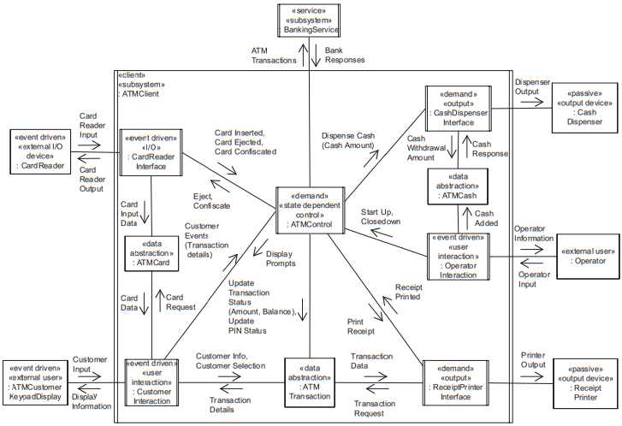
10 Design Of ATM Client Subsystems
Task architecture: initial concurrent communication diagram for ATM client subsystem

Slide 36
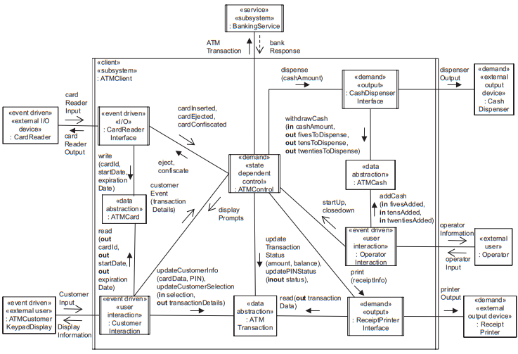
10 Design Of ATM Client Subsystems
Task architecture: revised concurrent communication diagram for ATM client subsystem

Slide 37
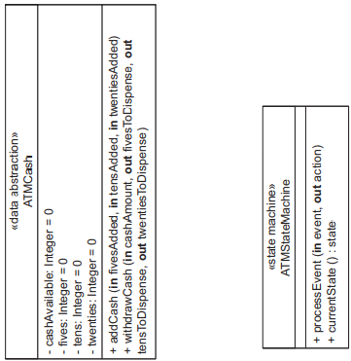
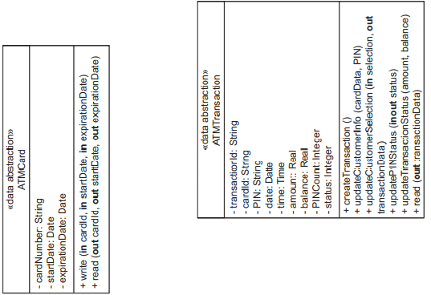
10 Design Of ATM Client Subsystems
ATM client information hiding classes

Slide 38
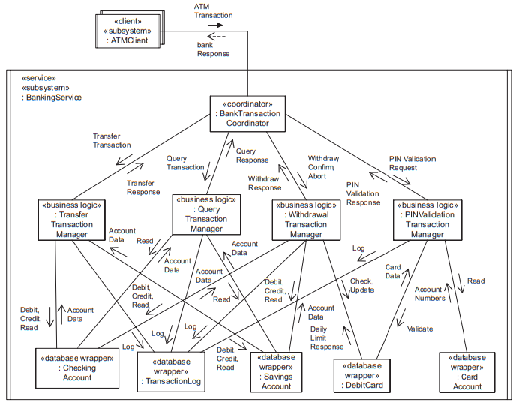
11 Design Of Banking Service Subsystems
The Banking Service Subsystem is designed as one sequential service task, which is activated on demand.
Inside the task are the coordinator object (the Bank Transaction Coordinator), the business logic objects (PIN Validation Transaction Manager, Withdrawal Transaction Manager, Query Transaction Manager, and Transfer Transaction Manager), and the entity classes, now categorized further as database wrapper classes.
The Bank Transaction Coordinator task receives the incoming transaction messages and replies with the bank responses. It delegates the transaction processing to the transaction managers, which in turn access the database wrapper objects.
Task architecture: initial concurrent communication diagram for Banking Service subsystem

Slide 39
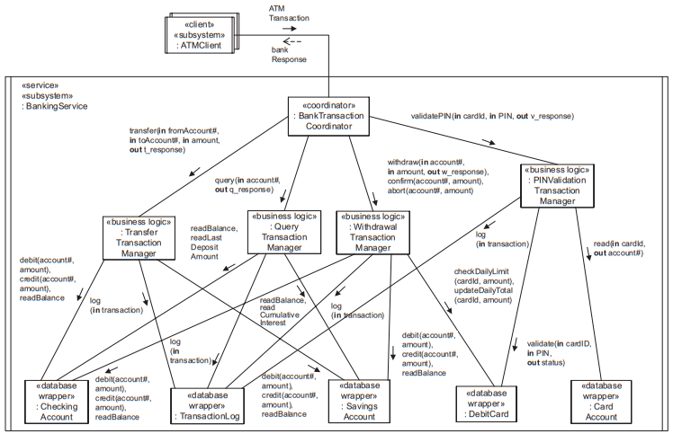
11 Design Of Banking Service Subsystems
Task architecture: revised concurrent communication diagram for Banking Service subsystem

Slide 40
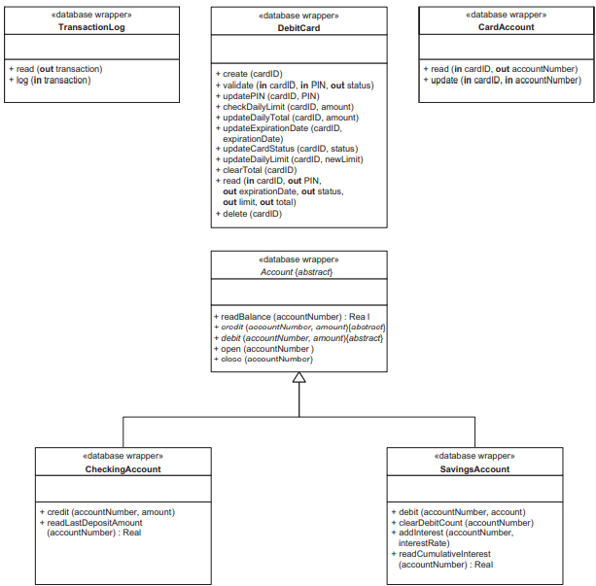
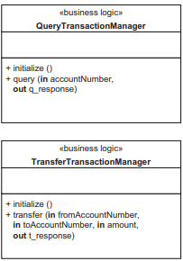
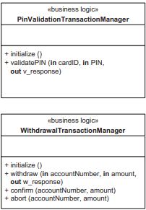
11 Design Of Banking Service Subsystems
Banking Service business logic classes
Banking Service database wrapper classes

Slide 41
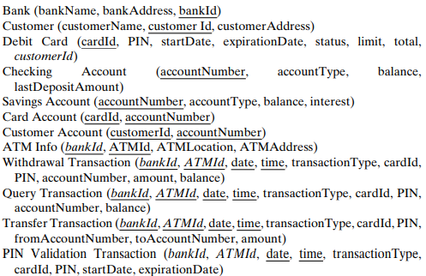
12 Relational Database Design

Slide 42
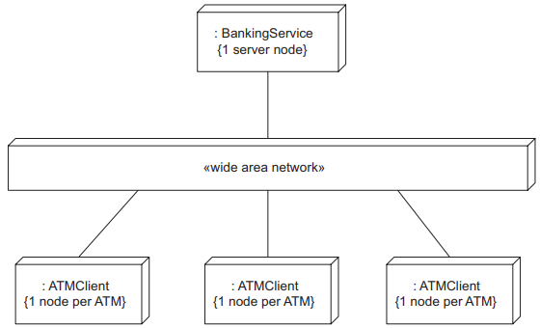
13 Deployment Of Banking System
Because this is a client/server system, there are multiple instances of the client subsystem and one instance of the service subsystem.
Each subsystem instance executes on its own node, as depicted in the deployment diagram.
Thus, each instance of the ATM Client executes on an ATM node, and the one instance of the Banking Service executes on the server node.
Deployment diagram for Banking System

Slide 43

14 Alternate Design Considerations
An alternative design decision is to design the Banking Service as a concurrent service, in which the Bank Transaction Coordinator and each of the business logic objects are designed as separate demand driven tasks that are activated on demand.
With this concurrent service design, the Bank Transaction Coordinator delegates a transaction to a business logic object and then immediately accepts the next transaction; thus, multiple transactions would be processed concurrently at the server.
This solution should be adopted if the sequential service design is inadequate for handling the transaction load.

Slide 44
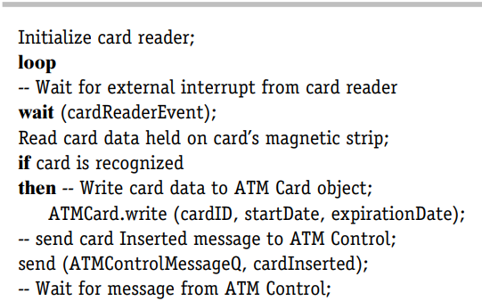
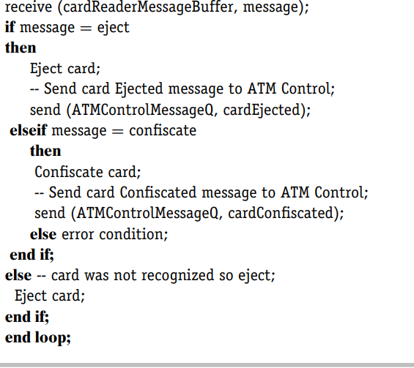
15 Detailed Design
Example of Event Sequencing Logic for Card Reader
Interface Task

Slide 45
Thank you for listening!

